Slide 1
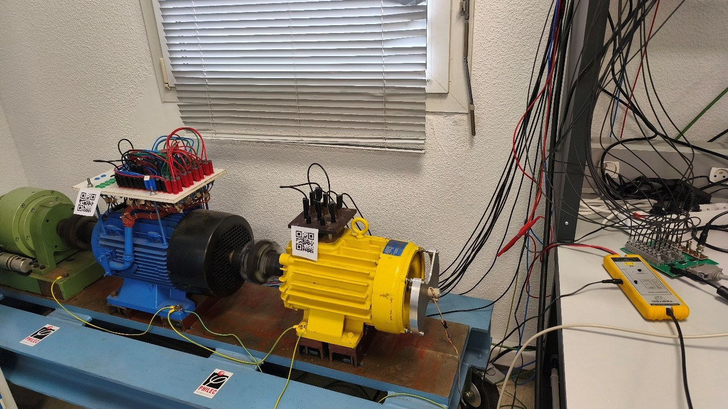
The 6th IEEE International Conference on Electrical Sciences and Technologies in Maghreb
Constantine, Algeria | October 27-29, 2026
Title of the paper
Author1, Author2, Author3
email???@g.enp.edu.dz
Ecole Nationale Polytechnique, Algiers, Algeria
Replace with University logo

Slide 2
Outline
Introduction
System description
Finite Element Analysis
Simulation model
Experiments
Conclusions and perspectives

Slide 3
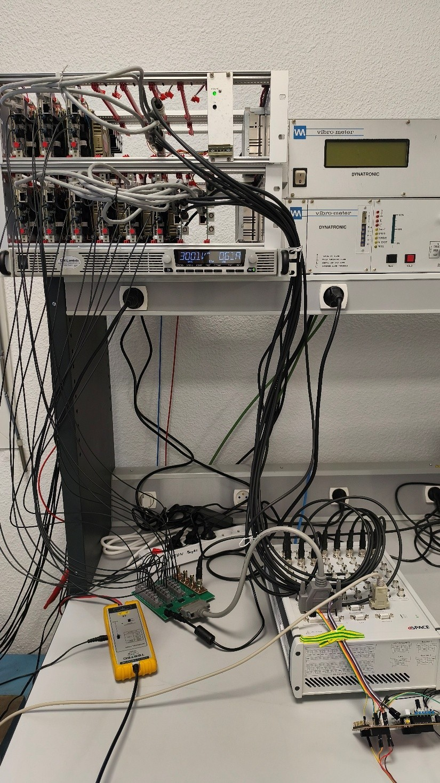
Introduction
Real-time Power Hardware-in-the-Loop (P-HIL)
Emulation of road profile
Simultaneous control of 2 motor-generators
Xxxxx
Xxxx
YYYYY yyyy
Power electronics (3+6 arms inverter) and MLBX

Slide 4
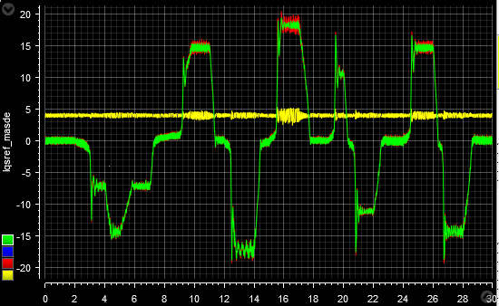
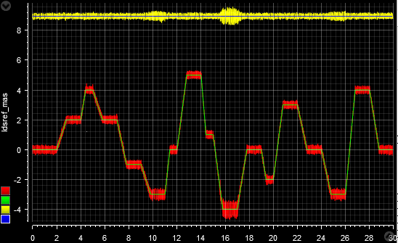

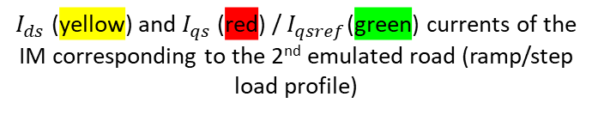
Experiments
Electrical vehicle (EV) road emulation
Double Star Induction Motor (DSIM): EV speed profile
IP speed controller
PI current controllers
Induction motor: Load profile
$I_{ds}$ (yellow) and $I_{qs}$ (red) / $I_{qsref}$(green) currents of the EV DSIM corresponding to the 2nd emulated road
$I_{ds}$ (yellow) and $I_{qs}$ (red) / $I_{qsref}$(green) currents of the IM corresponding to the 2nd emulated road (ramp/step load profile)

Slide 5
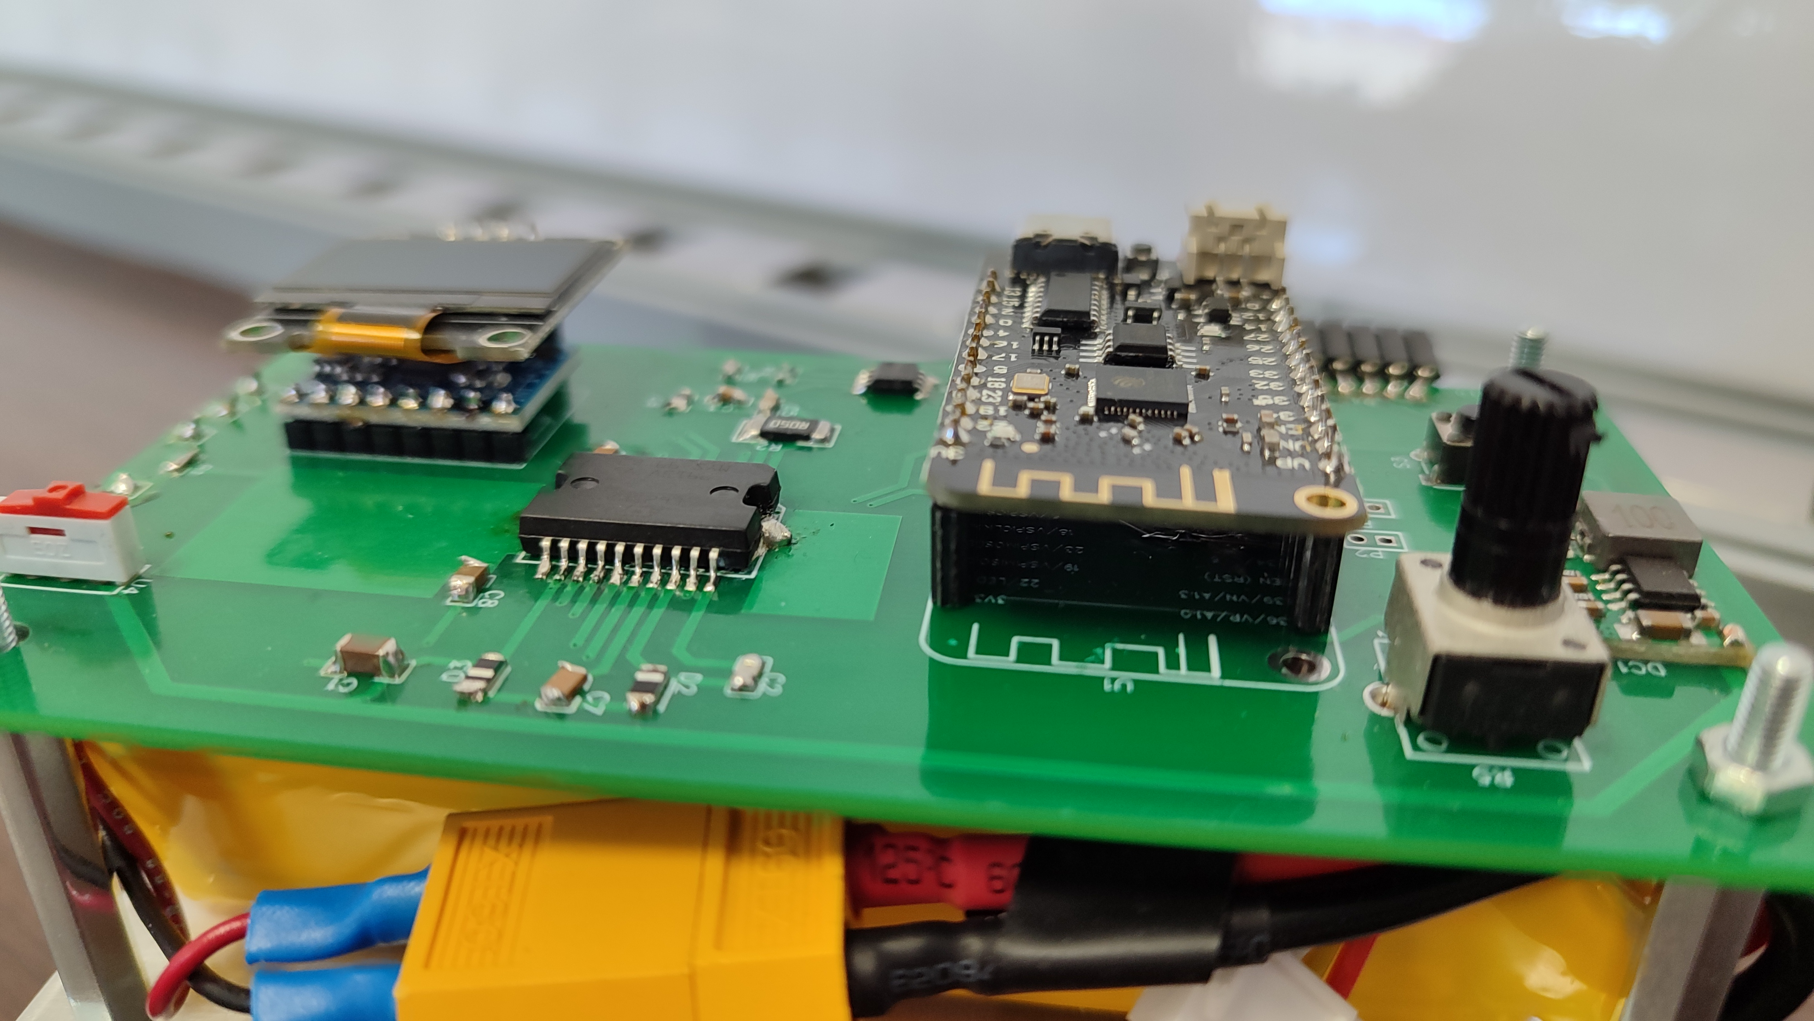
Conclusions and perspectives
Open structure, learn with fun
Many possible studies: Electrical machine, Power Electronics, Control, Programming, Real-time
Torque, speed and what else
Difficult to manufacture and reproduce
Use IMU with data fusion for better speed and position estimation
Non linear super inter ultra extra control
Useless addition of complexity

